Slide 1
19.07.2018
SUMO
Intellilight
13.05.2019
04.08.2019
05.11.2019
22.03.2021
CityFlow
PressLight
CoLight
Simulate with Sparse Trajectory Data
04.08.2019
12.05.2019
03.11.2019
A Thousand Lights
Learning Phase Competition (FRAP)
DemoLight: TSC from Demonstrations
??.??.2020
??.??.2020
MetaLight
Vehicle Trajectories from Demonstrations

Slide 2
SUMO vs CoLight
(based on GPT-4 queries)
Both implemented in C++ with python API
Colight 10-1000x faster, but lacks support for other vehicle types
SUMO: slower, but much more versatile

Slide 3
Intellilight: Deep RL for traffic signal control
04.08.2019
proposes two major contributions:
memory palace: seperate memory into different categories to reduce biases in generated data.
group by pairs (phase, action)
sample uniformly from categories to learn equally for all situations
phase gate: depending on the current phase, a different set of dense layers is used in the NN.
this makes it easier for the network to change it's behaviour based on the current phase
(explicit interpretation of the policy, not just looking at rewards)

Slide 4
FRAP – Learning phase competition for traffic signal control
12.05.2019
make RL for TSC more efficient by leveraging symmertries in traffic flows.

Slide 5
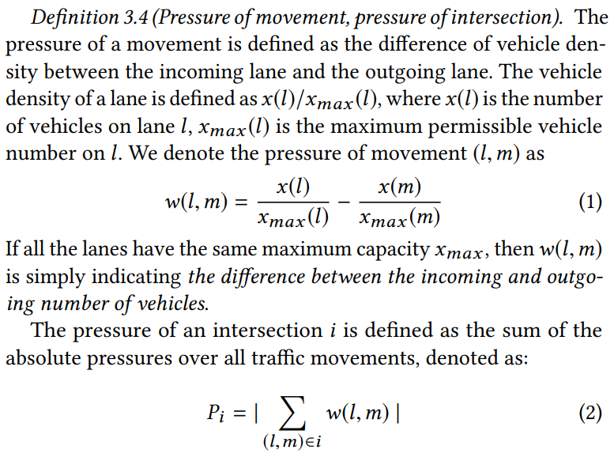
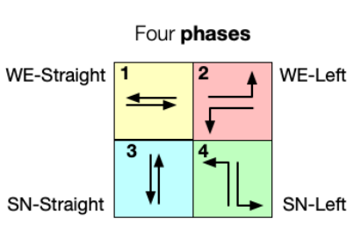
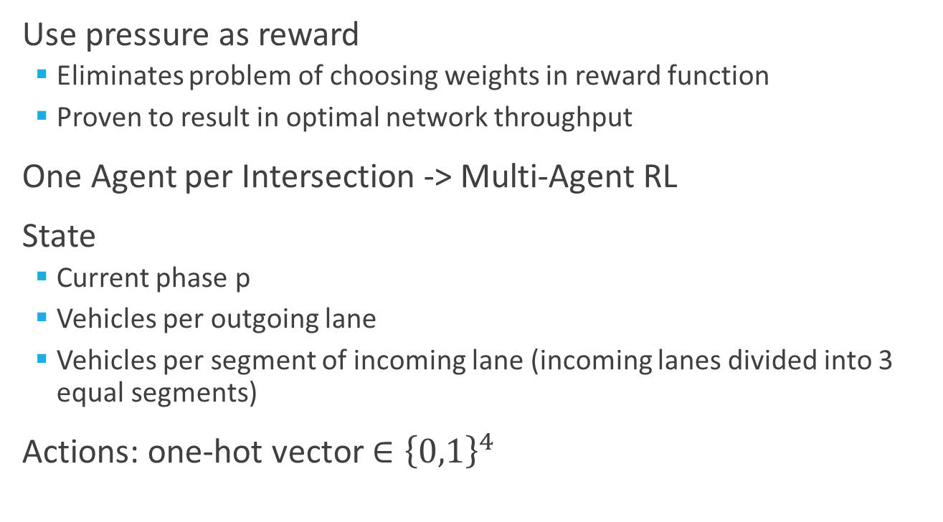
PressLight
04.08.2019
Use pressure as reward
Eliminates problem of choosing weights in reward function
Proven to result in optimal network throughput
One Agent per Intersection -> Multi-Agent RL
State
Current phase p
Vehicles per outgoing lane
Vehicles per segment of incoming lane (incoming lanes divided into 3 equal segments)
Actions: one-hot vector $∈{\left\{0,1\right\}}^{4}$

Slide 6
PressLight - Questions
04.08.2019
compute resources? What hardware was used and how long did training take?
Do all agents share their weights? – no?
Are agents trained on individual intersections or do they vary during training? (especially for heterogenous networks)
What was the training setup? What is contained in an episode?
What arrival rates were used in training?

Slide 7
Colight – Communication between agents through GATs
05.11.2019
agents also consider states of neighbouring intersections (message passing through GCNNs)
agents learn importance of neighbouring intersections through attention values
see next slide for GAT/ GNN explanation

Slide 8

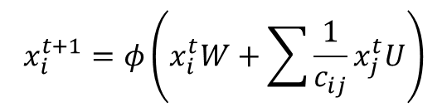

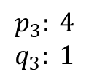

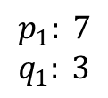

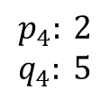

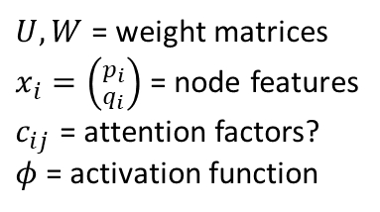
Colight – Graph Attentional Neural Networks (GATs) for traffic signal control
05.11.2019
GATs use Graph layers:
GNN | NN
Node | Neuron
Neighbouring nodes | Previous neurons
Permutation invariant combination of neighbouring nodes | Affine combination of previous neurons
Activation function | Activation function
Graph in, graph out | Tensor in, tensor out
$$p_{3}: 4$$
$$q_{3}: 1$$
$$p_{4}: 2$$
$$q_{4}: 5$$
$U,W$ = weight matrices
$x_{i}=\left({p_{i} \atop q_{i}}\right)$ = node features
$c_{ij}$ = attention factors?
$φ$ = activation function
$$x_{3}$$
$$x_{4}$$
$$p_{2}: 5$$
$$q_{2}: 3$$
$$p_{1}: 7$$
$$q_{1}: 3$$
$$x_{2}$$
$$x_{1}$$
$$x_{i}^{t+1}=φ\left(x_{i}^{t}W+\sum{\frac{1}{c_{ij}}x_{j}^{t}U}\right)$$
messages from neighbours
GNN explanation: https://www.youtube.com/watch?v=GXhBEj1ZtE8

Slide 9
DemoLight: speed up training of DRL TSC through demonstrations
Start training of DRL TSC agents with A2C demos from classical methods, then fine-tune
Promises faster, more consistent convergence and better final performance

Slide 10
A Thousand Lights - MPLight
03.04.2020
RL has been shown to improve single-intersection performance
decentralized Deep RL agents
use PressLight, but with FRAP network instead of simple DQN
use same NN for all intersections => good performance on Manhatten network
FRAP performs better than PressLight => combination = MPLight
aims to adress three key issues:
scalability (through parameter sharing),
coordination (through pressure) and
data feasibility (only use easily obtainable data)

Slide 11
Vehicle Trajectories from Demonstrations
learn more accurate vehicle simulations from real-world data
use generative adversarial imitation learning framework
result: more realistic traffic trajectories

Slide 12
Simulation with sparse trajectory data
learn to improve real-world data through interpolation and behavioral imitation to improve traffic simulation

Slide 13
Safety for DRL-based traffic signal control systems
Adversarial attacks through malicious communication between vehicles:
https://arxiv.org/abs/2111.02845 - references Intellilight, CoLight
Robust Deep RL by adding noise to learning data:
https://par.nsf.gov/servlets/purl/10214068 - references Intellilight, Presslight

Slide 14
Potential research topics
extend models to include pedestrians, cyclists ,emergency vehicles etc.
extend models to include phases for right-turning vehicles, pedetrian & cyclists
to prevent exponential growth of action space, use binary action-vectors, not one-hot encoding.
increase model robustness through RL-based adversarial attacks
simulate bad vehicle behaviour (crashes, unnecessary waiting etc.), train/ fine-tune TSC agent to prevent harm
make learning process more efficient (i.e.: https://arxiv.org/abs/2111.08067 ModelLight proposes learning world models to improve data-efficiency)

